Slide 1
COACHES DISTRIBUTION
8-2-23

Slide 2
WELCOME TO CHINO HILLS AYSO 779
Coach information 2016
Interim Coach Administrator:
Steve Young, coachadmin@ayso779.org
Interim Coach Coordinator:
Jason Tinsley, u16u19@ayso779.org

Slide 3
CHINO HILLS AYSO REGION 779
WE ARE AN ALL-VOLUNTEER ORGANIZATION
WE ARE CELEBRATING OUR 32nd YEAR AS A REGION!
WE ARE ONE OF THE LARGEST REGIONS IN THE SURROUNDING AREA OFFERING OVER 1,000 KIDS THE CHANCE TO PLAY SOCCER!

Slide 4
SIX AYSO PHILOSOPHIES
Everyone Plays
Each player must play at least 75% of each game.
Balanced Teams
Good Sportsmanship
Open Registration
Player Development
Positive Coaching

Slide 5
DIVISION COORDINATORS
Coed 5- Ryleigh Andresen
Boys 6U –JJ Guillen
Girls 6U – Liz Tafolla
Boys 8U – Kayla Warmkessel
Girls 8U – Richard Viola
Boys 10U – Ryan Lewis
Girls 10U – Ryan Lewis*
Boys 12U – Ed O’Connell
Girls 12U – Eric Guignard
Boys 14U – Jeff Simonton
Girls 14U – Jeff Simonton
16U/19U - Jason Tinsley

Slide 6
AYSO AGE MATRIX
Playground for players 3 years old (2020) on or before Dec. 31st
5U for players 4 years old (2019) on or before Dec. 31st
6U for players 5 years old (2018) on or before Dec. 31st
8U for players 6 or 7 years old (2016/17) on or before Dec. 31st
10U for players 8 or 9 years old (2014/15) on or before Dec. 31st
12U for players 10 or 11 years old (2012/13) on or before Dec. 31st
14U for players 12 or 13 years old (2010/11) on or before Dec. 31st
16U for players 14 or 15 years old (2008/09) on or before Dec. 31st
19U for players 16, 17, or 18 years old (2005/06/07) on or before Dec. 31st

Slide 7
MANDATORY COACH MEETING
Wednesday, AUGUST 23rd Online meeting
Tentative schedule is below:
5U/6U division meeting – 5:15-5:45pm
8U division meeting – 6:00-6:30pm
10U division meeting – 6:45-7:15pm
12U/14U division meeting – 7:30-8:00pm
Go over important details for the season with the Division Coordinator, Coach Administrator & Coach Coordinator

Slide 8
COACH CERTIFICATIONS
All Coaches (Head Coach and Asst. Coach) must have the following 8 items completed to be certified to coach.
1. Current 2023 Volunteer Form:
Sign up on ayso.bluesombrero.com
Link is at www.ayso779.org
2. Safe Haven Certification
(if completed in 2016 or later, does not have to be redone):
Sign in to www.aysou.org
Found in Online Courses, then Safe Haven courses
Complete all sections
Free of charge

Slide 9
COACH CERTIFICATIONS
3. Concussion Training Certification (only need to complete once):
Sign in to www.aysou.org
Found in Online Courses, then Safe Haven Courses
Complete all sections of the course
Free of charge
4. Sudden Cardiac Arrest Training
Sign in to www.aysou.org
Found in Online Courses, then Safe Haven Courses
Complete all sections of the course
5. Complete Background check via Risk Status link
In your volunteer account click the renew and update all links.

Slide 10
COACH CERTIFICATIONS
6. Complete Live scan at the region sponsored live scan on picture day, September 9, 2023.
7. Safe Sport Training.
All Training is easily accessible from the volunteer page under your account. You can select the box on the item you want to complete and then renew and update.
8. Upload your picture on your user profile.
This is found in your sports connect account, upload a headshot of you for your coach badge.

Slide 11
COACH CERTIFICATIONS
IN PERSON Coach Certification Training (Sign up for course on www.aysou.org)
10U divisions: U10 Coach (August 12th or 13th at Ontario Super Camp)
12U divisions: U12 Coach (August 12th or 13th at Ontario Super Camp) Complete online pre-course and register for in person class
14U divisions: Intermediate Coach (August 12th at Ontario Super Camp. U12 coach and online Intermediate pre-course completed as prerequisites)
U16/19 divisions: Advanced Coach (August 13th at Ontario Super Camp Intermediate coach and online Advanced pre-course completed as prerequisites)

Slide 12
AYSO 779 COACH CERTIFICATION CLINICS
12U, Intermediate and Advanced coach certification classes
Can attend any class offered by our region or a region nearby
Sign up on www.aysou.org (NO SIGNUPS. ON SITE, SIGN UP PRIOR)
Click “In Person Courses"
Click the blue Sessions tab for the coach level course needed
Click the blue Register tab for the course to are signing up for
Read the information for location and anything that needs to be completed prior to the certification course.
Time on the field is required so wear comfortable clothes and shoes geared for activity.
MUST SIGN IN AND SIGN OUT TO COMPLETE COURSE

Slide 13
COACH ID BADGES
2023 Picture ID badge MUST be worn at practices and games by the Head and Assistant Coaches.
Coaches must wear the 2023 Badge only.
ID badges will be printed only when the 8 coach certification items have been completed.
ID badges are for the safety of the coach.
Pictures for ID badges will be uploaded by you on your sports connect site
ID badges will be available for pick up at the Region tent of your game site once ALL of your certifications are complete, starting on the first day of games.
Coaches will sign in at the Board tent before their game and show their badge. This is for ALL divisions!

Slide 14
COACH SUPPLIES
THE REGION WILL PROVIDE ALL HEAD COACHES:
3 Soccer balls
First Aid Kit
Pinnies for ½ your team (8U and above)
16U and 19U will get pinnies by request
12 Cones
Coach T-shirt
Ball bag

Slide 15
COACH CONDUCT
POSITIVE COACHING to all players
Be Prepared and Organized
POSITIVE SIDELINE CONDUCT
Respectful to Referees- zero tolerance policy in place
Good communication with parents
Expectations from you, players and parents
ALWAYS have player registration forms at practices and games
Get your parents involved!
Remember the kids are here to HAVE FUN!

Slide 16
PRACTICE SITES
10U-19U teams only…Practice slots will be assigned on first come, first serve. Practices can begin as early as July 31st, 2023
ONLY TEAMS in Divisions 10U-19U teams can practice at Community Park
Times: Field 3 4:15-5:30pm; 5:30-6:45pm; 6:45pm-8pm
Times: Fields 1 and 5 4:30-5:45pm; 5:45-7:00pm; 7:00-8:15pm
Days: Monday/Wednesday OR Tuesday/Thursday
PLEASE BE RESPECTFUL OF FIELD SPACE AND TIME!
SOCCER GOALS SHOULD NOT BE USED and ABSOLUTELY CANNOT BE MOVED!

Slide 17
PRACTICE SITES
5U-8U will practice at AYSO allowed parks and schools within the city limits.
Alterra Park, Butterfield Ranch Elementary, Townsend Jr. High or Canyon Hills Jr. High
Practices should be no more than an hour each day and NO more than 2 hours in a week for 5U-8U
Coach picks day(s) and times convenient to them. Email your division coordinator when and where you will be practicing.
Locations that are OFF limits:
Ayala High School
Chaparral Elementary
Chino Hills High School
Country Springs Elementary
Eagle Canyon Elementary
English Springs Park
Locations that are OFF limits:
Fairfield Park
Glenmeade Elementary
Hunters Hill Park
Litel Elementary
Los Serranos Elementary
Oakridge Elementary

Slide 18
PRACTICE SITES
Townsend Jr. High and Canyon Jr. High under strict rules by the district.
Coaches MUST finish practices by 6:30pm at these two locations and be off premises by 6:45pm
We need to leave these two locations cleaner than when you arrived. Please pick up all trash
Be respectful of school staff
Please take a before and after picture of facility as proof that we did not leave the facility in an unacceptable state
Any issues need to be reported to your coordinator immediately
Need a list of all teams practicing at these two facilities

Slide 19
COACH/PARENT MEETING
Decide on a Team Name –
check with division coordinator that name is not duplicated prior to ordering banner, etc.
HAVE EVERY FAMILY SIGN UP FOR AT LEAST ONE POSITION!
Get a Sponsor - Determines order of uniform color selection
Assistant Coach
All teams are encouraged to have an assistant coach
Volunteer will need same certifications as head coach
Referees
At least 3 per team, shouldn’t be the coach; Certifications provided by Region
Designate a Team Parent
Set up/Take down helpers
Banner Coordinator
Treasurer
Snack Coordinator

Slide 20
UK TRAINING
UK Trainers will be assigned to our region from August 21st –November 2nd.
Friday Night Foot Skills will be available to players in ALL divisions.
Run by the UK training staff
Begins Friday, August 25th and ends on Friday, October 27th at Community Park.
5U-8U: 5:15-6:15pm – Field 4
10U-14U: 6:30-7:45pm – Field 4
Free to all 2023 registered players, sign in on site.

Slide 21
5U & 6U GUIDELINES
Four 5 minute quarters with a 5 minute half time break.
Games are 5-V-5.
Players are required to play a minimum of 3 quarters of the game. (Our region has players participate for the entire game)
**Player substitutions are performed on a quarter basis.
Direct free kicks only (indirect free kicks are not allowed).
All out of bounds restarts will be with a pass in. ***No Throw ins
No goal kicks or corner kicks.
No heading of the ball.
No offside infractions.
Goalkeepers are not permitted.
Home team provides referee.
Coaches are not allowed on the field.
Coaches and referees must sign in at board tent prior to game.
Scores and standings are not kept.
Soccer ball: Size 3

Slide 22
8U GUIDELINES
Four 10 minute quarters with a 5 minute half time break.
Games are 6-V-6. With Goal Keepers
Players are required to play a minimum of 3 quarters of the game.
Player substitutions are performed on a quarter basis.
Free kicks (direct and indirect), goal kicks, and corner kicks are allowed.
Throw ins are allowed.
No offside infractions.
No heading of the ball.
Home team provides a referee.
Coaches are not allowed on the field.
Coaches and referees must sign in at board tent prior to their game.
Scores and standings are not kept.
Soccer ball: Size 3

Slide 23
NO HEADING RULE 12U AND BELOW
1. Consistent with the U.S. Soccer mandates on heading the ball, heading is banned for all division players U-11 (U-12 and below for programs without single age divisions) and below in both practices and games.
Heading for players in U-14 is limited to a maximum of thirty (30) minutes per week with no more than 15-20 headers, per player. There is no restriction on heading in matches.
2. An indirect free kick will be awarded to the opposing team if a player age 10 or younger, deliberately touches the ball with his/her head during a game.
a. The indirect free kick is to be taken from the place where the player touched the ball with his/her head.
b. An indirect free kick awarded to the attacking team inside the opposing team’s penalty area, must be taken on the penalty area line parallel to the goal line at the point nearest to where the player touched the ball with his/her head.
3. Neither cautions nor send offs shall be issued for persistent infringement or denying an obvious goal scoring opportunity related to the heading infraction.

Slide 24
10U GUIDELINES
TWO - 25 minute halves with a 5 minute half time break.
Games are 7-V-7. A minimum of 5 players on each team are required for the game to be played.
Players are required to play a minimum of 3 quarters of the game.
Player substitutions are performed on a quarter basis.
Rules and regulations are per FIFA’s Laws of the Game.
No heading of the ball.
***No punting by the goalkeeper.
***Goal kicks and goalkeeper possession will have a Build-Out line.
***The Build-Out line shall be used as the line to determine offside. (use to be the half line)
Coaches are not allowed on the field.
Coaches and referees must sign in at board tent prior to their game.
Scores and standings are kept.
Teams are required to provide a center and assistant referee for their team.
Soccer ball: Size 4

Slide 26
12U GUIDELINES
TWO – 30 minute halves with a 5 minute half time break.
Games are 9-V-9. A minimum of 6 players on each team are required for the game to be played.
Players are required to play a minimum of 3 quarters of the game.
Player substitutions are performed on a quarter basis.
Rules and regulations are per FIFA’s Laws of the Game.
No heading of the ball.
Goalkeeper may punt the ball.
Coaches are not allowed on the field.
Coaches and referees must sign in at board tent prior to their game.
Scores and standings are kept.
Teams are required to provide a center and assistant referee for their team.
Soccer ball: size 4

Slide 27
14U GUIDELINES
TWO – 35 minute halves with a 5 minute half time break.
Games are 11-V-11. A minimum of 7 players on each team are required for the game to be played.
Players are required to play a minimum of 3 quarters of the game.
Player substitutions are performed on a quarter basis.
Rules and regulations are per FIFA’s Laws of the Game.
Coaches are not allowed on the field.
Coaches and referees must sign in at board tent prior to their game.
Scores and standings are kept.
Teams are required to provide a center and assistant referee for their team.
Soccer ball: Size 5

Slide 28
16U GUIDELINES
TWO – 40 minute halves with a 5 minute half time break.
Games are 11-V-11. A minimum of 7 players on each team are required for the game to be played.
Players are required to play a minimum of 50% of the game.
Free substitution of players is allowed.
Rules and regulations are per FIFA’s Laws of the Game.
Games are primarily played during the week.
Opponents will include teams from other regions.
Schedules, scores, and standings are through the Area 1U website.
Soccer ball: Size 5

Slide 29
19U GUIDELINES
TWO – 45 minute halves with a 5 minute half time break.
Games are 11-V-11. A minimum of 7 players on each team are required for the game to be played.
Players are required to play a minimum of 50% of the game.
Free substitution of players is allowed.
Rules and regulations are per FIFA’s Laws of the Game.
Games are primarily played during the week.
Opponents will include teams from other regions.
Schedules, scores, and standings are through the Area 1U website.
Soccer ball: Size 5

Slide 30
COACH CONTACTS
In case of any concern, the person to contact is your DIVISION COORDINATOR.
Division Coordinator will contact Coach Administrator or Referee Administrator.
Coach Administrator or Referee Administrator will contact the Regional Commissioner.
PLEASE RELAY ANY QUESTIONS OR CONCERNS TO YOUR DIVISION COORDINATOR!

Slide 31
AYSO LAW CHANGES
Spirit of the Game
Soccer is designed to be a player’s sport and the involvement of non-players, such as Coaches and Referees, is intended to be limited.
Soccer is a fast-paced sport that should flow with minimal interruptions. Referees have considerable flexibility when determining whether or not to stop play.
Highlights of FIFA law changes for 2023/2024:
Hair beads, clips, and other adornments may be worn, but must be
Securely fastened to the head
Do not present an increased risk to the player, teammates, or opponents
Flat clips less than two inches in length may be used to hold the hair in place close to the head
Hair charms are still considered jewelry and are not permitted

Slide 32
AYSO LAW CHANGES
Highlights of FIFA law changes for 2023/2024:
Hair beads, clips, and other adornments may be worn, but…

Slide 33
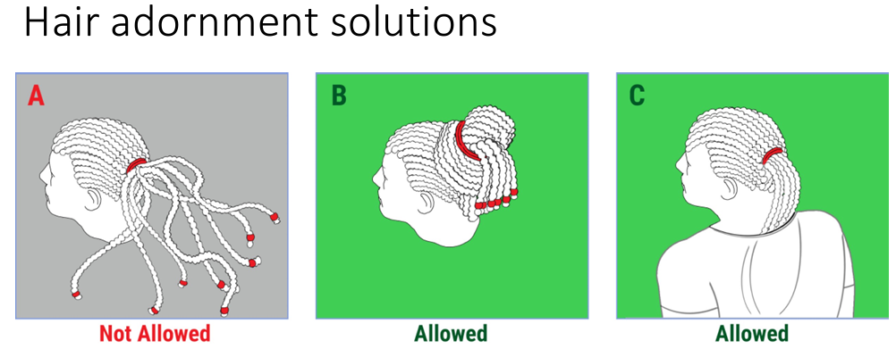
AYSO LAW CHANGES
Highlights of FIFA law changes for 2023/2024:
Hair beads, clips, and other adornments may be worn, but…

Slide 34
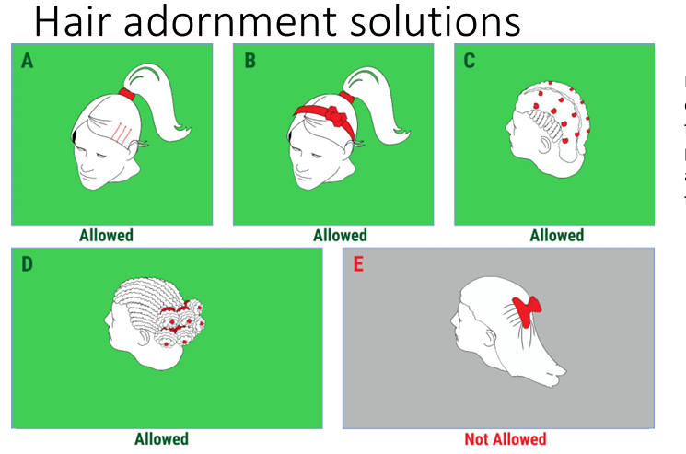
AYSO LAW CHANGES
Highlights of FIFA law changes for 2023/2024:
Hair beads, clips, and other adornments may be worn, but…

Slide 35
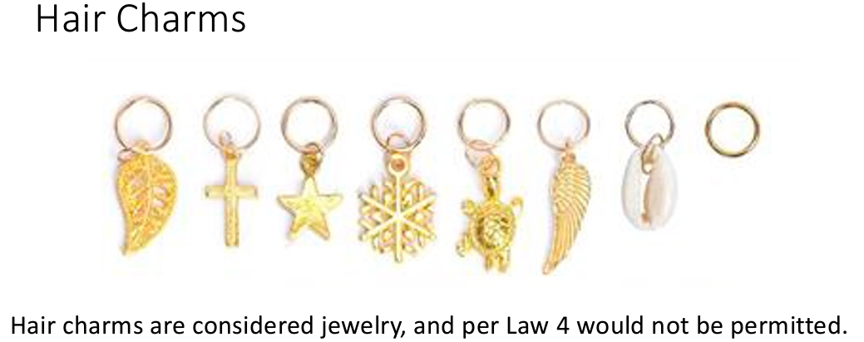
AYSO LAW CHANGES
Highlights of FIFA law changes for 2023/2024:
Hair beads, clips, and other adornments may be worn, but…

Slide 36
Post Season Invitational Acceptance Guidelines
Post Season Invitational Tournament (10U-14U only)
A post season invitational tournament is held at the conclusion of the regular season for the U10 through U14 divisions. The only requirement to be eligible for the post season invitational is that a team must maintain 25 points.
Each team starts off with 30 points. 20 of these points are referee points and 10 are team sportsmanship points.
Each team will be required to supply an AR for 10 games and a Center Referee for approximately 5 games.
Each team will provide an AR for their own game to be positioned on their sideline.
The Home team will be required to provide a Center Referee for the game prior to their own.
In the instance of the last game of the day the Visiting team of the 2nd to last game will provide the Center Referee for the Last game of the day.
Referees will be assigned to teams. Coaches will submit a referee form with a list of their referees similar to that of a Tournament Referee Form. Ref Admins will verify eligibility.
2 referee points are deducted for each missed center referee assignment.
1 referee point is deducted for each missed assistant referee assignment.
Sportsmanship points are deducted for coach ejections or warnings. Sideline behavior is key to keeping your points.
A team not earning the required referee and sportsmanship points will not be invited to participate in the post season invitational tournament regardless of the team’s standings at the end of the season.
The winners of the championship matches in each division will automatically advance to the Area 1B Fall Tournament which will be held in January.
The Referee and Coach Administration will determine eligibility based on points.

Slide 37
Coaching Resources
The coaching manual will be available to all coaches after attending one of two webinars hosted by the Coaching Manual team on how to use the content. More information to follow.
www.thecoachingmanual.com

Slide 38
THANK YOU FOR VOLUNTEERING! YOU MAKE A DIFFERENCE!

